Slide 1


PHISHING AWARENESS TRAINING
PRESENTED BY
ALFI JINAN ABDUL NASSAR
30/05/2024

Slide 2

Contents
3
Introduction to Phishing
8
Social Engineering Tactics
4
Common Types of Phishing Attacks
9
Preventive Measures
5
Recognising Phishing
E-mails
10
Responding to Phishing Attacks
7
Recognising Phishing Websites
11
Tool

Slide 3

Introduction to Phishing
Definition: Explain what phishing is.
Phishing is a cyber attack that uses disguised email as a weapon. The goal is to trick the email recipient into believing that the message is something they want or need.
Importance of Awareness: Discuss why it's crucial to be aware of phishing.
Phishing can lead to data breaches, financial loss, and identity theft.

Slide 4



Common Types of Phishing Attacks
Email Phishing:
Fake emails from seemingly legitimate sources.
Spear Phishing:
Targeted phishing aimed at specific individuals.
Whaling:
Phishing attacks targeting high-profile individuals like executives.
Smishing and Vishing:
Phishing via SMS (smishing) and voice calls (vishing).
Clone Phishing:
A legitimate, previously delivered email is used to create an almost identical email with malicious links or attachments.

Slide 5

Recognizing Phishing Emails
Red Flags:
Suspicious Sender: Check the sender’s email address carefully.
Generic Greetings: Be cautious of emails starting with "Dear Customer."
Urgency and Threats: Beware of emails urging immediate action.
Unusual Attachments or Links: Don’t click on unexpected links or attachments.
Spelling and Grammar Mistakes: Legitimate companies usually don’t make spelling or grammatical errors.
.

Slide 6
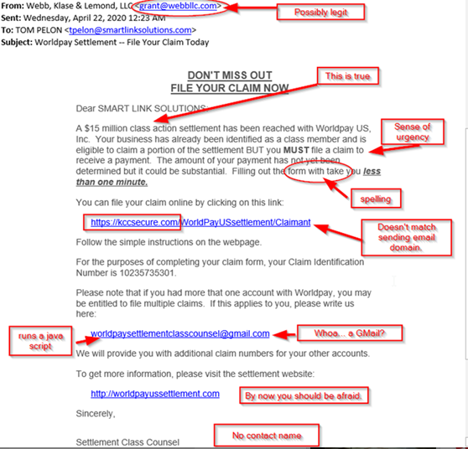

E
X
A
M
P
L
E

Slide 7
Recognizing Phishing Websites
Check the URL:
Ensure the website URL is correct and starts with "https://".
Look for the Padlock:
A padlock symbol in the address bar indicates a secure connection.
Design and Content:
Poor design, unusual pop-ups, or requests for personal information can be indicators.

Slide 8

Social Engineering Tactics
Pretexting:
Creating a fabricated scenario to steal information.
Baiting:
Offering something enticing to gain access to information.
Tailgating:
Gaining physical access by following someone into a restricted area.

Slide 9
Preventive Measures
Email Security Practices:
Don’t click on links or open attachments from unknown sources.
Verify the sender’s email address.
Use email filtering tools.
Website Security Practices:
Always type the URL directly into the browser.
Use bookmarks for frequently visited sites.
General Security Practices:
Use multi-factor authentication (MFA).
Keep software and antivirus up to date.
Regularly back up data.
Training and Awareness:
Regular phishing awareness training for all employees.
Simulated phishing exercises.

Slide 10

Responding to Phishing Attacks
If You Suspect Phishing:
Don’t respond to the email or click on any links.
Report the email to your IT department.
Delete the email.
If You’ve Been Phished:
Change your passwords immediately.
Contact your IT department or service provider.
Monitor your accounts for unusual activity.

Slide 11
TOOL
Blackeye is an open-source phishing tool that is designed to automate the creation of phishing pages and capture user credentials. Blackeye functions by generating a fake login page that imitates the appearance and functionality of the target website or service, tricking the user into providing their login credentials

Slide 12
THANK YOU

